Slide 1
Outline
Software Development life cycles (SDLCs)
Key reasons for integrating into SDLC
Integrating security into each SDLCs

Slide 2
Software Development Life Cycles (SDLC Models)
Waterfall Model
V-Model (Verification and Validation Model)
Iterative Model
Agile Model
Spiral Model
Big Bang Model
DevOps Model

Slide 3
Waterfall Model
A linear and sequential model where each phase must be completed before moving to the next.
Phases:
1. Requirements Gathering
2. System Design
3. Implementation (Coding)
4. Testing
5. Deployment
6. Maintenance
Pros:
✔️ Simple and easy to understand
✔️ Well-structured with clear milestones
Cons:
❌ No flexibility for changes after the initial phase
❌ Late testing phase increases risk of defects
Best Used For:
• Small, well-defined projects• Regulated industries (e.g., healthcare, banking)

Slide 4
V-Model (Verification and Validation Model)
An extension of the Waterfall model, where every development phase is directly linked to a corresponding testing phase.
Phases:
1. Requirement Analysis → Acceptance Testing
2. System Design → System Testing
3. Architectural Design → Integration Testing
4. Module Design → Unit Testing
5. Implementation
Pros:
✔️ Early detection of defects due to continuous testing
✔️ Clearly defined verification and validation steps
Cons:
❌ Expensive to implement due to extensive testing
❌ Not flexible for mid-project changes
Best Used For:
• Critical applications (e.g., embedded systems, defense, aerospace)

Slide 5
Iterative Model
Developers build the software in small iterations (or cycles) instead of delivering everything at once.
Phases:
1. Requirement Analysis
2. Design &amp; Development
3. Implementation
4. Testing &amp; Evaluation
5. Deployment
6. Repeat (Iterations continue until final product)
Pros:
✔️ Early detection of issues
✔️ Allows gradual improvement and customer feedback
Cons:
❌ Can be costly due to multiple iterations
❌ Requires extensive management
Best Used For:
• Complex projects where requirements evolve

Slide 6
Agile Model
A flexible and adaptive model where development is incremental and iterative, emphasizing customer collaboration.
Key Agile Frameworks:
• Scrum – Uses sprints (2-4 week development cycles)
• Kanban – Focuses on continuous workflow without predefined iterations
• Extreme Programming (XP) – Focuses on customer satisfaction, frequent releases, and
coding best practices
Pros:
✔️ Highly flexible to changes
✔️ Faster delivery with continuous feedback
Cons:
❌ Requires experienced developers
❌ Difficult to estimate cost and time
Best Used For:
• Startups, SaaS, mobile applications
• Projects with frequently changing requirements

Slide 7
Spiral Model
A risk-driven model that combines Waterfall and Iterative models, adding risk assessment at each phase.
Phases in Each Cycle:
1. Planning
2. Risk Analysis
3. Development &amp; Testing
4. Evaluation &amp; Refinement
Pros:
✔️ Identifies risks early
✔️ Allows frequent revisions and adjustments
Cons:
❌ Complex to manage
❌ Can be expensive due to risk assessment
Best Used For:
• High-risk, large-scale projects (e.g., AI, FinTech, Cybersecurity)

Slide 8
Big Bang Model
A highly flexible approach where development starts without formal planning, and everything is built in one go.
Pros:
✔️ Simple and fast for small projects
✔️ No rigid structure
Cons:
❌ High risk of failure
❌ Not suitable for large projects
Best Used For:
• Small, experimental projects
• R & D and prototype development

Slide 9
DevOps Model
A modern SDLC approach that integrates development (Dev) and operations (Ops) for continuous integration and deployment (CI/CD).
Key Components:
• Continuous Integration (CI) – Automated code integration
• Continuous Deployment (CD) – Frequent and automated releases
• Infrastructure as Code (IaC) – Automated infrastructure management
Pros:
✔️ Faster software releases
✔️ Improved collaboration between teams
Cons:
❌ Requires strong automation and DevOps expertise
❌ Complex implementation in traditional organizations
Best Used For:
• Cloud applications, microservices, enterprise

Slide 10
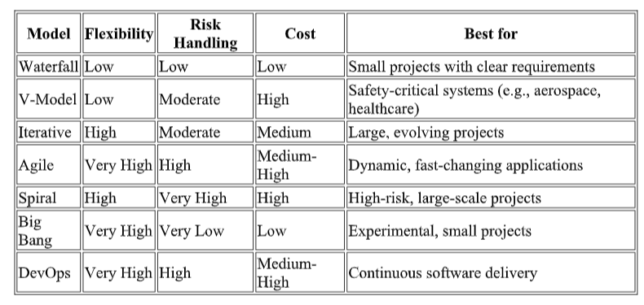
Comparison Table of SDLC Models

Slide 11
Key Reasons for Integrating Security into SDLC

Slide 12
Key Reasons for Integrating Security into SDLC
1. Early Detection and Mitigation of Security Vulnerabilities
• Identifying and fixing security issues in the early phases of development is far more cost-
effective than addressing them post-deployment.
• Studies show that fixing a security flaw during the requirement or design phase costs
significantly less compared to fixing it in production.
2. Reduced Costs of Security Fixes
• IBM’s Cost of a Data Breach Report highlights that post-release bug fixes and breaches cost
companies millions.
• By integrating security early, companies reduce the need for expensive remediation efforts,
legal liabilities, and reputational damage.
3. Enhanced Compliance with Security Regulations
• Many industries have strict regulatory requirements (e.g., GDPR, HIPAA, PCI-DSS, ISO 27001).
• Security integration ensures that applications are designed with compliance in mind, avoiding
potential penalties.

Slide 13
Key Reasons for Integrating Security into SDLC
4. Protection Against Emerging Threats
• Cyber threats are constantly evolving, requiring security teams to be proactive rather than
reactive.
• Implementing threat modeling and risk assessments during development helps anticipate
attack vectors before they become real-world threats.
5. Improved Software Quality and Reliability
• Security best practices (e.g., secure coding, authentication mechanisms, and encryption)
improve overall software quality.
• Reducing vulnerabilities minimizes system crashes, data corruption, and performance issues.
6. Increased Customer Trust and Business Reputation
• Secure software leads to higher user trust and credibility.
• Companies that integrate security into SDLC demonstrate a commitment to data protection andprivacy, attracting more customers.

Slide 14
Integrating Security into Each SDLC Phase

Slide 15
Integrating Security into Each SDLC Phase
1. Requirement Analysis (Planning Phase)
• Use Security Requirement Engineering (SRE) frameworks.
2. Design Phase
• Implement secure design patterns (e.g., input validation, encryption, authentication).
3. Development Phase
• Implement code reviews with security focus.
4. Testing Phase
• Perform Dynamic Application Security Testing (DAST) to detect vulnerabilities in running applications.

Slide 16
Integrating Security into Each SDLC Phase
5. Deployment Phase
• Ensure secure configurations before deploying applications.
6. Maintenance and Monitoring Phase.
• Implement patch management and incident response plans.
• Conduct periodic security audits and compliance checks.
Integrating security into the SDLC is not optional—it is a necessity in modern software development.
A proactive security approach ensures that security is an inherent part of the software, reducing risks, costs, and vulnerabilities.

